Slide 1
Creating a web server with Node.js

Slide 2
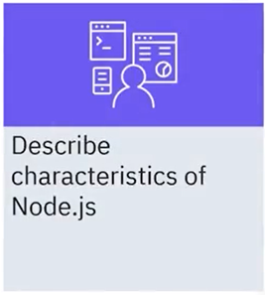
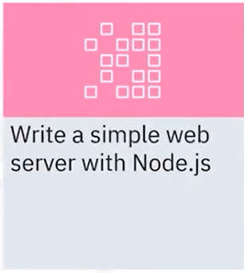
What you will learn

Slide 3


Node.js: Server-side JavaScript
• Node.js is a server-side programming framework that uses JavaScript as its programming language
• Many developers are already familiar with the JavaScript language
Node.js

Slide 4

Node.js: Server-side JavaScript
• Heavy emphasis on concurrent programming with a lightweight language
• Single-threaded application that handles input/output (I/O) operations through events
• Callback functions that handle results when they complete

Slide 5

Node.js: Server-side JavaScript
For building server applications that are
• Scalable
• Concurrent
• Developed quickly with a minimal set of
tools

Slide 6
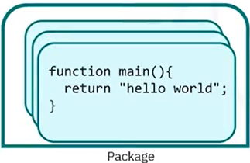
Node.js modules
• Every JavaScript file is a module in Node. js
• Multiple modules can be grouped into a package
function main(){
return "hello world" ;
}

Slide 7
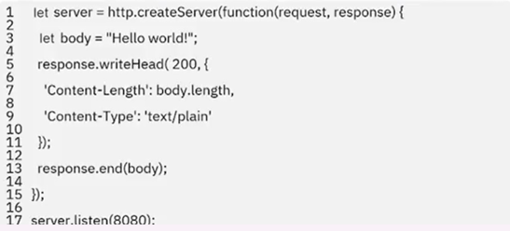
Create a simple web server: http
• With the http Node.js module, you can develop an application
that listens to HTTP requests and returns HTTP response messages

Slide 8
Recap
In this video, you learned that:
• Node.js is a single-threaded application environment that
handles I/O operations through events
• Every JavaScript file is a module in Node.js
• With the http Node.js module, you can develop an application
that listens to HTTP requests and returns HTTP response
messages

